Slide 1


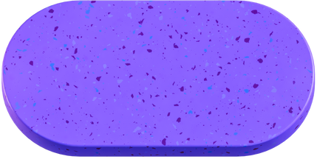


InAgri
Information of Agriculture – Smart Crop Recommendation System
TEAM NAME- AGRICO
MEMBER ROLL NO-24CSEAIML201
24CSEAIML123
LEARNATHION 4.0
Built With: Google Colab, Python,
Scikit-learn,
Pandas, Matplotlib

Slide 2
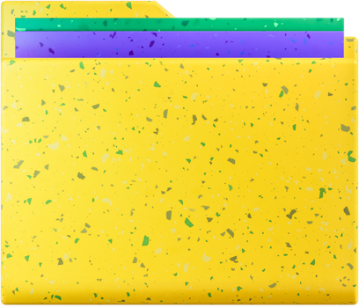

Overview
InAgri (Information of Agriculture) is an intelligent, ML-powered crop advisory system designed to assist farmers and agri-planners in selecting the most suitable crops based on soil health, climate conditions, and profitability.
Built entirely on Google Colab, InAgri combines data science, agriculture knowledge, and visual dashboards to deliver actionable insights.
GOALS
Empower farmers to make informed crop choices using data
Promote sustainable agriculture through crop rotation insights
Estimate costs and profitability for better planning
Make agri-intelligence accessible to all via a no-install, interactive dashboard
Lay the foundation for a future-ready, real-time AgriTech assistant

Slide 3
PROBLEM STATMENT
Farmers often lack:
Awareness about soil conditions
Knowledge of market trends
Guidance on sustainable farming
This leads to:
Low yield and profit
Unsuitable crop selection
Soil exhaustion
loss of fertility

Slide 4
SOLUTION
A smart agri-intelligence tool that:
Recommends the Top 3 crops based on soil & weather data
Displays detailed crop information
Calculates cost, revenue & profit
Suggests crop rotation plans for sustainability
Presents everything in a visual, interactive dashboard
The API helps the farmer to increase profit after each crop.
suggest the farmer when to plant the crop

Slide 5



Key Features of InAgri
Top 3 Crop Recommendations
Crop Information Panel
Ideal soil, season, irrigation, fertilizer tips
Cost-Profit Estimator
Calculates estimated revenue and profit per acre
Crop Rotation System
Suggests next-season crops for sustainability
Dashboard
Pie and bar charts with crossfilters

Slide 6
Impact & Benefits
Empowers farmers to make data-driven crop decisions
Promotes sustainable agriculture through rotation
Helps boost yield and income
Easy to access – runs on Colab, no installation needed
Future-ready for integration with mobile/web apps

Slide 7
Future Scope
Integrate with real-time weather APIs
Link to market price data from AgMarkNet
Add multi-language support (Hindi, regional)
Build mobile/web version using Streamlit or React
Collect feedback to improve model over time

Slide 8
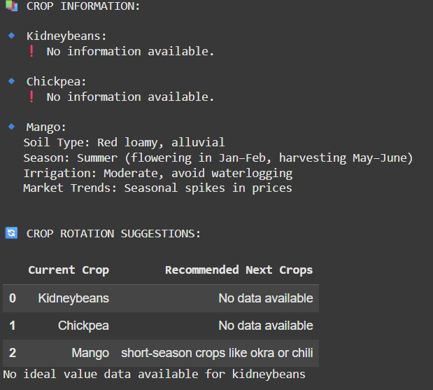
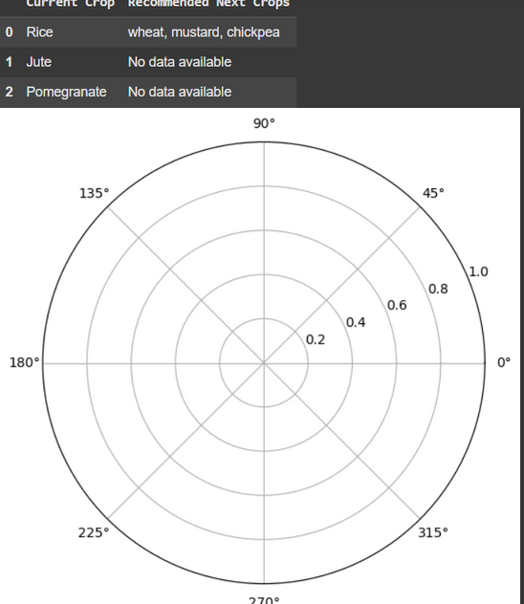
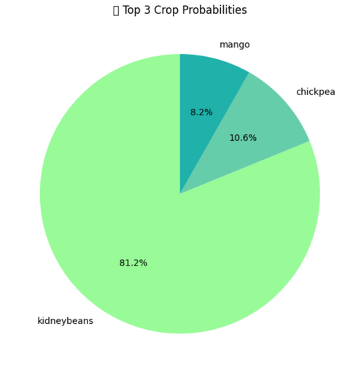
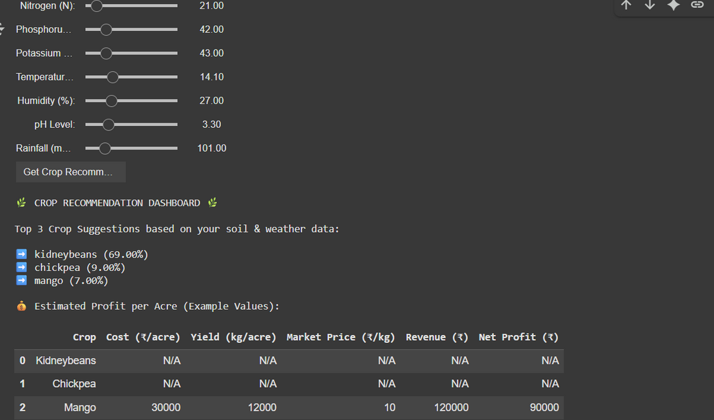
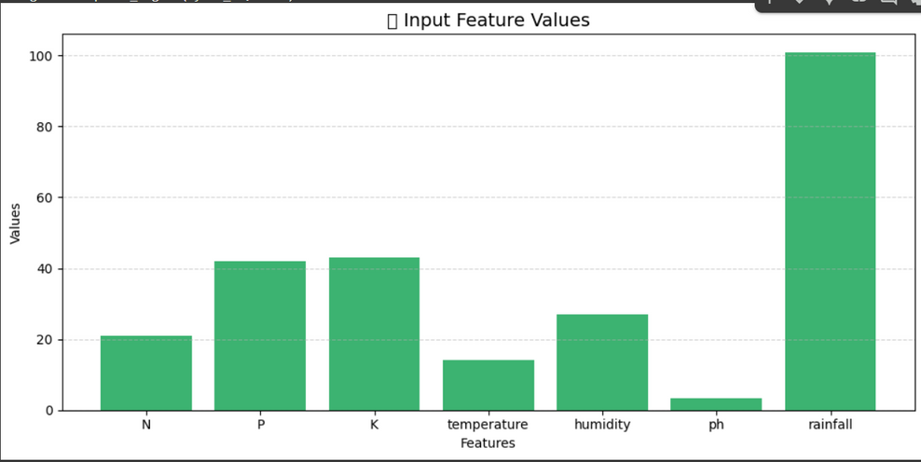
SAMPLE OUTPUT
SCREENSHOT OF THE OUTPUT FROM THE ML MODEL

Slide 9
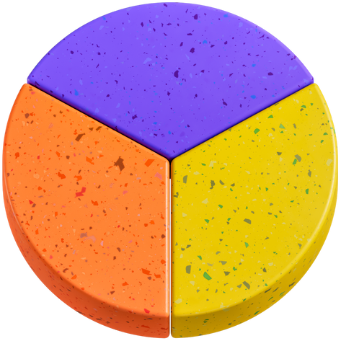
Dataset & Tools
Dataset: Crop Recommendation Dataset from Kaggle
Tools Used:
Google Colab (Notebook Environment)
Scikit-learn (ML model)
Pandas, NumPy (data handling)
Matplotlib, Plotly (visualizations)
ipywidgets (interactivity)
Your paragraph text

Slide 10
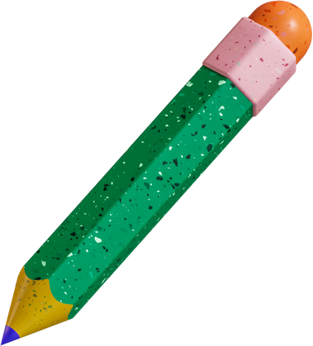
Machine Learning Model
Algorithm: Random Forest Classifier
Accuracy: 99% on test data
Input Features:
N, P, K levels
Temperature, Humidity, Rainfall
Soil pH
Output: Most suitable crop(s)

Slide 11
Thank You
Let’s make agriculture smarter, together.

